Slide 1
Machine Learning
South Fayette Pilot

Slide 2
Selling your idea
In the weighted majority algorithm, we learned about online learning which can take multiple datapoints and adjust weights so that it can predict which friend may have the closest tastes in movies to your own.
Now let’s look at a different applications of weights.

Slide 3

Selling your idea
Problem:
How would one classify this handwritten digit? It’s not very well written and the resolution of the image is low.

Slide 4
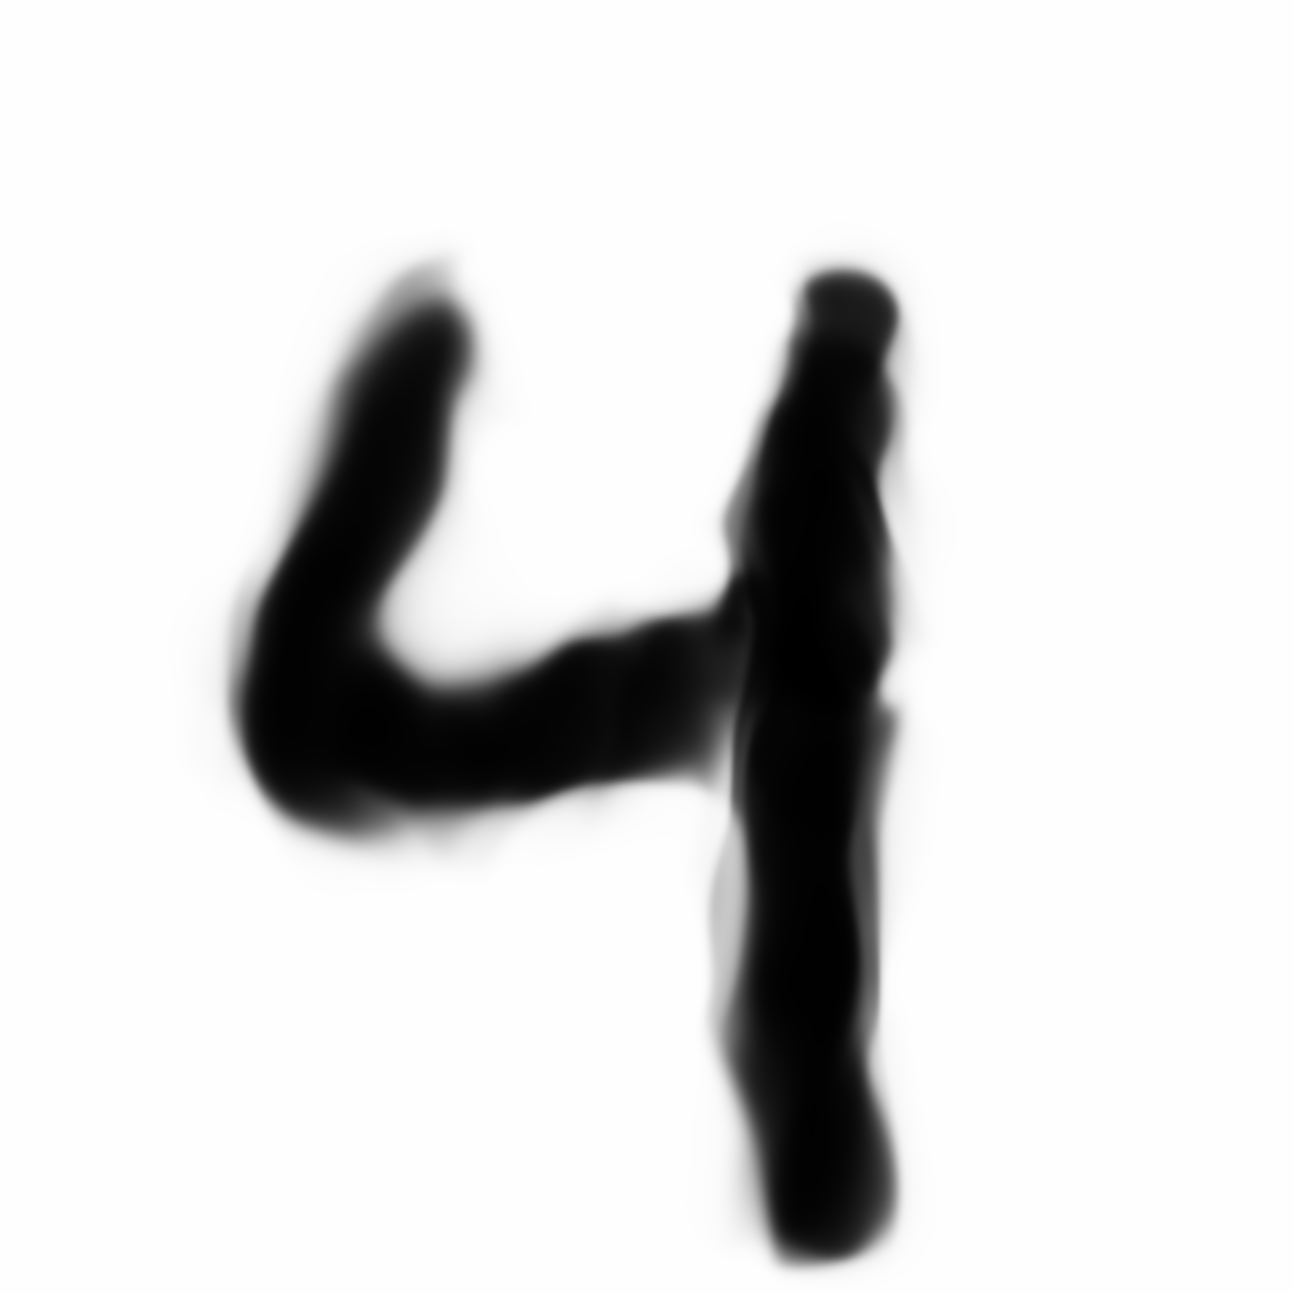
Selling your idea
You can look at this from pixel values.
The image is composed of 28 x 28 pixels.
It is understood that our brain takes these 28 x 28 pixels (784 pixels) and understands it as a “4”.
28
28

Slide 5
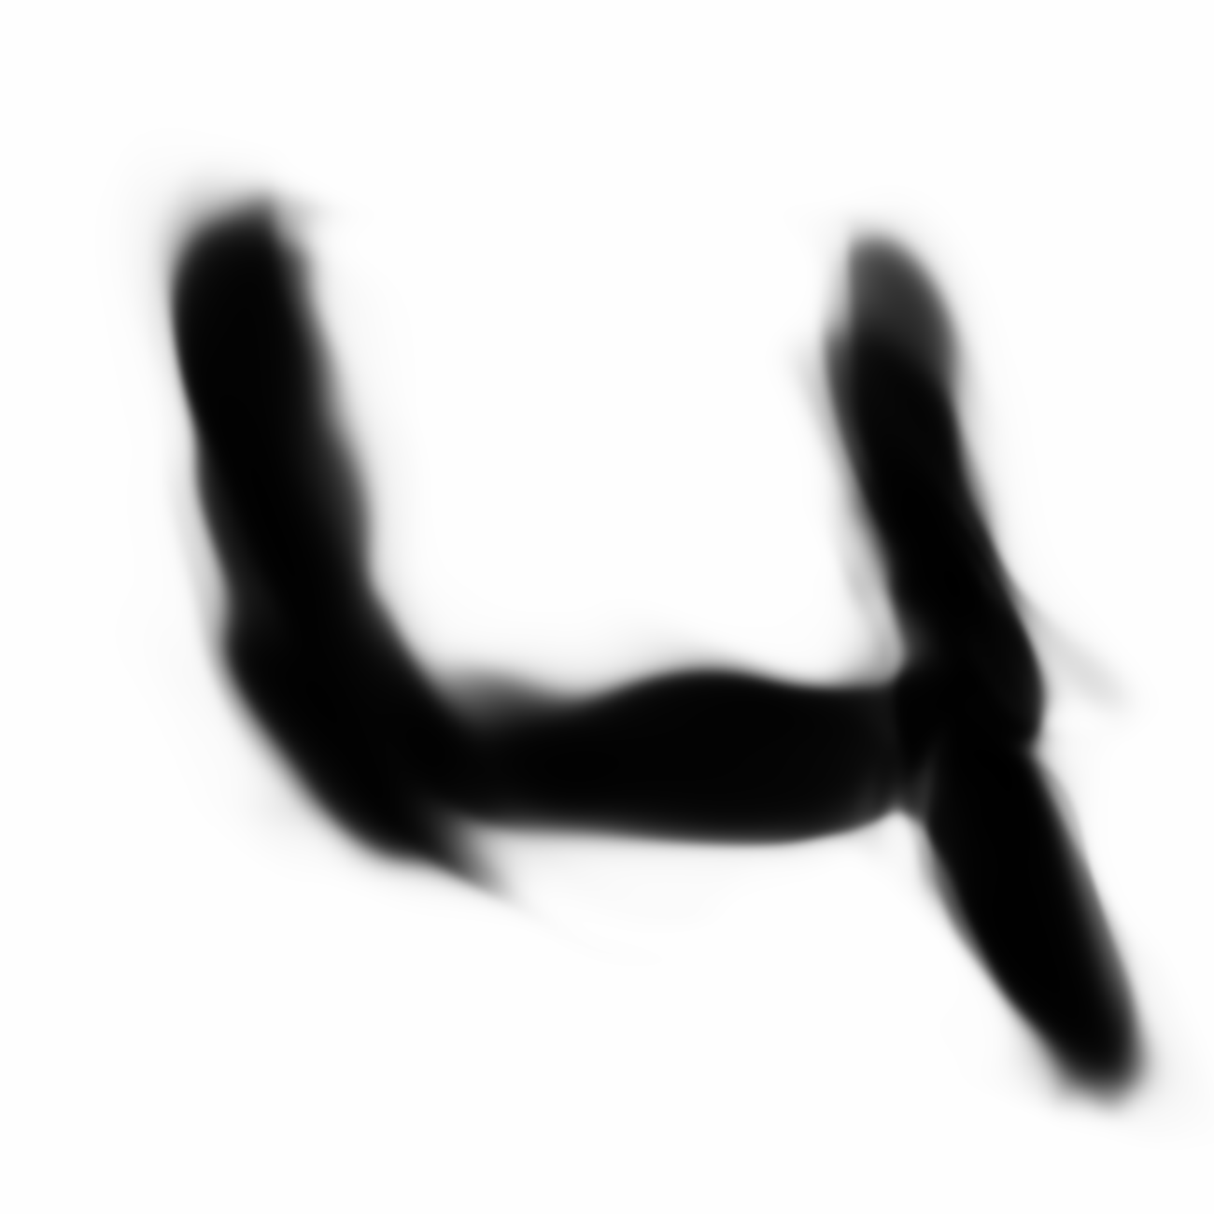

But look at these others.
It seems fairly obvious to the human eye and brain that these are all “4” but the pixel values are very different. The neurons in our brain firing for each “4” are different than the others but the brain understands them all the same. They very obviously can see the right most is a “6”
Selling your idea
=
=
!=

Slide 6
Selling your idea
The algorithm we will use, a neural network
will try to solve this mystery and problem.
28
0
1
2
3
4
5
6
7
8
9
Neural
Network
28

Slide 7
Selling your idea
It must be stated that neural networks can be used to
Solve many problems. This is just one example.
28
0
1
2
3
4
5
6
7
8
9
Neural
Network
28

Slide 8
Selling your idea
The algorithm we will use, a neural network
will take in the 28x28 grid of pixels, stack them into an array and output a prediction of class 0-9… one class for each digit.
28
0
1
2
3
4
5
6
7
8
9
Neural
Network
28

Slide 9
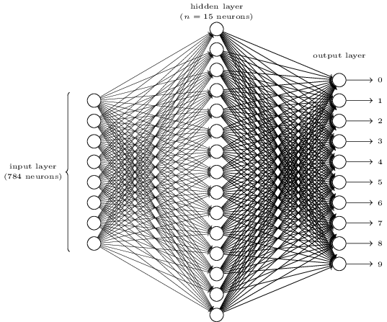
Let’s see what a neural network actually is and how it actually makes this prediction.
28
28

Slide 10
The hope is that you will understand the structure and the reason why they work.
28
28

Slide 11
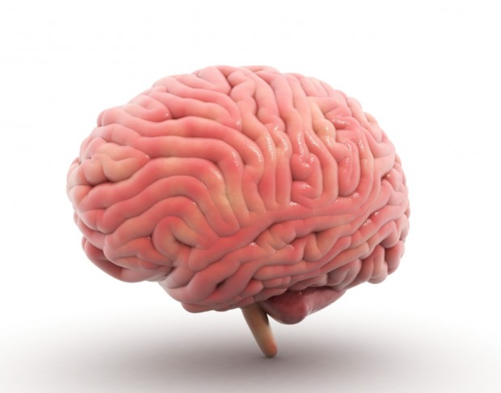
On a broad level, neural networks are composed of layers of neurons and draw influence by way the brain works.
28
1
a layer
2
1
3
2
...
3
28
4
5
6
a neuron
7
...
8
783
9
784
10

Slide 12
In this case, the hope is that after the 784 (28x28) pixels go into the Neural network as 784 input neurons the correct output of “4” is predicted of the 10 output neurons.
It is important to note that this design of a neural network is specific to this problem.
28
1
a layer
output
input
2
1
3
2
...
3
28
4
5
6
a neuron
7
...
8
783
9
784
10

Slide 13
But how are these neurons and layers linked together? What exactly is in a neuron? And how are they all connected like in the picture?
28
1
a layer
2
1
3
2
...
3
28
4
5
6
a neuron
7
...
8
783
9
784
10

Slide 14
At first, you can simply think of a neuron as something that holds a number between 0 and 1. This value is called an “activation”. The idea is that the neuron is “lit up” if the “activation” is a high enough number.
So for the 784 pixels, the “activations” held in the
Corresponding 784 input neurons are the grayscale
Values between 0 and 1. 0 is completely white and 1
Is completely black.
.48
1
2
1
3
2
28
...
3
.08
4
5
28
6
.95
7
...
The “activations” at the output 10 neurons represent how much the neural network believes it is that corresponding digit. 1 for absolutely sure. 0.0 for the opposite.
8
783
9
784
10

Slide 15
As you can see their are two “hidden layers” between the input layer and the output layer. The amount of “hidden layers” is chosen by the programmer as are the number of neurons in each layer.
An important idea is that the activations of the
previous layer’s neurons directly effect the
activations of the subsequent layer’s neurons.
.48
1
2
1
3
2
28
...
3
.08
4
5
28
6
.95
7
...
8
783
9
784
10

Slide 16
So the “activations” for a 4 digit propagate through the middle layers in a manner that the 4 output neuron gets the highest activation at the end.
28
1
2
1
3
2
...
3
28
4
5
6
7
...
8
783
9
784
10

Slide 17

And in this example the “activations” for a 7 digit propagate through the middle layers in a manner that the 7 output neuron gets the highest activation. So the input 784 pixel values causes a ripple effect that somehow makes the 7 output the highest.
28
1
a layer
2
1
3
2
...
3
28
4
5
6
a neuron
7
...
8
783
9
784
10

Slide 18
Note that this network is already trained. That means that if we put in a digit 0-9, the neural network will give the highest activation of the output for that digit. We will learn later how to train this network later.
28
1
a layer
2
1
3
2
...
3
28
4
5
6
a neuron
7
...
8
783
9
784
10

Slide 19
First, why should we hope though that this structure of neurons and layers thinks intelligently? What are we expecting these layers and neurons to be doing?
28
1
a layer
2
1
3
2
...
3
28
4
5
6
a neuron
7
...
8
783
9
784
10

Slide 20
When we look at a digit, we broadly see that for instance that the digits break down into parts.
=
+
=
+

Slide 21
And we can see that even this components can be broken down into even smaller edges.
=
+
+
V b
V b

Slide 22
Ideally, this network in the layer before the output would represent these small edges with all of the activated edges adding up to a 7. The next hidden layer would represent combinations of edges...until finally we get to the full 7 at the end.
1
a layer
V b
2
1
3
2
...
3
4
5
V b
6
7
...
8
783
9
784
10

Slide 23
Of course this idea of breaking things down into smaller and smaller abstraction and adding them up work for other uses of neural networks. Audio for instance. In an audio classifying neural network, the first hidden layer should be sounds, the second syllables, perhaps a third with words etc.
1
a layer
V b
2
1
3
2
...
3
4
5
V b
6
7
...
8
783
9
784
10

Slide 24
So how do we choose the numbers and the calculations to make all of this work?
Remember for our example, there are 784 activation inputs. They are represented by a1, a2, a3... a784. The idea is that each of the lines from a neuron from the previous layer to the next are assigned a WEIGHT number w1, w2, w3…...w784.
Thus the weighted sum for the next layers is:
a1*w1 + a2*w2 + a3*w3 ……………. an*wn
a1
a2
w1
a3
...
...
w784
a783
a784

Slide 25
a1*w1 + a2*w2 + a3*w3 ……………. an*wn
This sum of products can be really big or really small depending on how positive or how negative the weights are.
a1
a2
w1
a3
...
-3
-2
-1
0
1
2
3
...
w784
a783
What we want though is the sum of products to be squished into a number between 0 and 1.
a784

Slide 26
a1*w1 + a2*w2 + a3*w3 ……………. an*wn
We will then put the sum of products into a function called a step function. Pictured below.
a1
a2
w1
a3
...
-3
-2
-1
0
1
2
3
...
w784
a783
Note that any numbers fed into the step function that is negative or highly negative are all zero. Conversely, any numbers positive or very positive are all 1.
a784

Slide 27
So our function is now
step( a1*w1 + a2*w2 + a3*w3 ……………. an*wn)
But what if we want to offset the activation to a different number and not have it just threshold at 0? Perhaps you want the neuron to become active at say 10? Then we just add 10. We call this a bias.
step( a1*w1 + a2*w2 + a3*w3 ……………. an*wn - bias) or
step( a1*w1 + a2*w2 + a3*w3 ……………. an*wn - 10) in this case.
a1
a2
w1
a3
...
...
w784
a783
a784

Slide 28
So there you have it. That is a connection from the first layer to a single neuron in the second layer. If there are 16 neurons in the second layer that now becomes 784 x 16 + 16 weights and biases or knobs and dials that have to be tweaked and changed for the entire connection between the first layer and second layer to make the network work.
a1
a2
w1
a3
...
...
w784
a783
a784

Slide 29
Now for this entire network with two hidden layers with 16 neurons in each hidden layer that is 784x16 + 16x16 + 10 x 16 + 16 + 16 + 10 = 13,002 weights and biases (!) that have to have the correct number to make it classify these digits correctly.
28
1
2
1
3
2
...
3
28
4
5
6
7
...
8
783
9
784
10

Slide 30
So how do we make this network LEARN the correct numbers to make it work. Thus far we have assumed the network already works perfectly!
28
1
2
1
3
2
...
3
28
4
5
6
7
...
8
783
9
784
10

Slide 31
A good general way to think about it is if the network actually classifies a digit incorrectly just going backwards and changing ALL the numbers connected. So in this example going from the misclassified output three changing the bias and the 16 weights, changing the 16 activations in the layer before…. Changing the 16 biases in that layer and the 16x 16 weights…. Changing the 16 biases in the layer before that ….and so on all the way back to the first weights and biases!
28
1
2
1
3
2
...
3
28
4
5
6
7
...
8
783
9
784
10

Slide 32
Going back quickly, now that we have a more nuanced understanding of how a neural network works, we can understand better that a neuron is not just a holder of an activation anymore. It is an activation but it is dependent on everything before it. We can now think of each neuron as a function now. A function of a sum of products of weights and biases with a step function applied to it.
a1
a2
w1
a3
...
...
w784
a783
a784

Slide 33
So how do we train this neural network. In other words, how do we create an algorithm that as you show it 28x28 pixel values of handwritten digits, it changes all 13,002 weights and biases to eventually learn to classify them all correctly?
28
1
2
1
3
2
...
3
28
4
5
6
7
...
8
783
9
784
10

Slide 34
As in previous exercises, we will have data on training and then we will have data for testing.
The first thing we do is we initialize all of the weights and biases randomly. So obviously, this will perform totally horribly in the initial goings. It will just output something random. But how do we measure how far off we are?
28
1
2
1
3
2
...
3
28
4
5
6
7
...
8
783
9
784
10

Slide 35
As in previous exercises, we will have data on training and then we will have data for testing.
The first thing we do is we initialize all of the weights and biases randomly. So obviously, this will perform totally horribly in the initial goings. It will just output something random. But how do we measure how far off we are?
28
1
2
1
3
2
...
3
28
4
5
6
7
...
8
783
9
784
10

Slide 36
We will call this measure of how far we are off a “cost function”. We want a function to measure how far the activations for the output are from the desired. In this case we want all activations to be 0 except for 7 which we want to be 1.
.71
1
2
.32
3
.98
4
.23
5
.77
.81
6
.58
7
.18
8
.18
9
.18
10

Slide 37
The cost function we will use will subtract the actual output for the neurons and add all of the differences.
.71
1
|.71-0| +
2
.32
|.32-0| +
3
.98
|.98-0| +
4
.23
|.23-0| +
.77
5
|.77-0| +
.81
6
|.81-0| +
.58
7
|.58-1| +
.18
8
|.18-0| +
.77
9
|.77-0| +
|.14 -0| = 5.33
.14
10

Slide 38
Note that when outputs are way way off, this number is big as in this example. Of course when the outputs are pretty close to correct, the numbers are small. THE IDEA IS TO FIND A WAY TO MAKE THIS NUMBER AS SMALL AS POSSIBLE
.71
1
|.71-0| +
2
.32
|.32-0| +
3
.98
|.98-0| +
4
.23
|.23-0| +
.77
5
|.77-0| +
.81
6
|.81-0| +
.58
7
|.58-1| +
.18
8
|.18-0| +
.77
9
|.77-0| +
|.14 -0| = 5.33
.14
10

Slide 39
Note that when outputs are way way off, this number is big as in this example. Of course when the outputs are pretty close to correct, the numbers are small. THE IDEA IS TO FIND A WAY TO MAKE THIS NUMBER AS SMALL AS POSSIBLE
.71
1
|.71-0| +
2
.32
|.32-0| +
3
.98
|.98-0| +
4
.23
|.23-0| +
.77
5
|.77-0| +
.81
6
|.81-0| +
.58
7
|.58-1| +
.18
8
|.18-0| +
.77
9
|.77-0| +
|.14 -0| = 5.33
.14
10

Slide 40
The general intuition about how to adjust is to think of 13,002 functions for all of the weights and biases.
The idea is that there is a function for every weight and bias in regards to the “cost function”. That’s 13,002 functions!
.71
1
|.71-0| +
2
.32
|.32-0| +
3
.98
|.98-0| +
4
.23
|.23-0| +
.77
5
|.77-0| +
.81
6
|.81-0| +
.58
7
|.58-1| +
.18
8
|.18-0| +
.77
9
|.77-0| +
|.14 -0| = 5.33 = C
.14
10

Slide 41
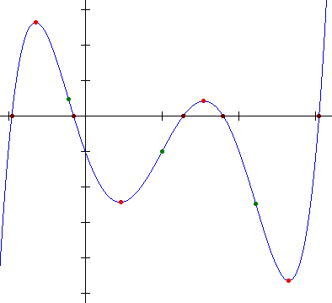
So here I’ve taken a random weight from our network. It is the 3,435th weight in our network. This is a function that plots the Cost C or the amount of Error with every other weight and bias in our network FIXED as a function of the value of the specific weight W3435. The blue dot
Represents the value of the weight after the first datapoint.
Cost (C)
Weight 3,435 (W)

Slide 42
Now imagine 13,001 other plots that also plot the Cost in relation to each weight and bias.
We minimize the overall cost and make our neural network work well by changing the weight to a point where Cost is the least.
Cost (C)
Weight 3,435 (W)

Slide 43
Now imagine 13,001 other plots that also plot the Cost in relation to each weight and bias.
We minimize the overall cost and make our neural network work well by changing the weight to a point where Cost is the least.
We have to widen our scope though because our Cost function is a function of 13,002 different weights and biases.
Cost (C)
Weight 3,435 (W)

Slide 44
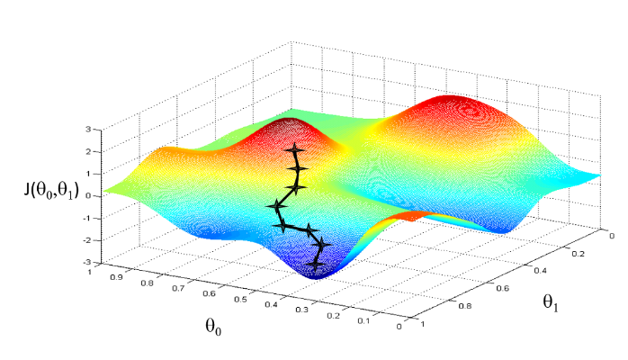
Let’s look at it from a broader angle. We can put two weights
on a x, y coordinate. In the plot to the right they are laid flat. On top on the z coordinate we can plot the cost function C(w1, w2) in relation to the two weights.
Our goal is with each new example of 784 pixels that are classified incorrectly, we want to move in a direction where we move in the fastest direction towards the minimum cost. How do we do this?
C(w1, w2)
w2
w1

Slide 45
Let’s look at one weight. First how would we find out what direction we would want to go to change the weight such that the Cost becomes less?
Cost (C)
Weight 3,435 (W)

Slide 46
In math we would look for the gradient. The gradient is the slope of the red line to the right. It is the slope of the line that is tangent to the single point of our weight.
Cost (C)
Weight 3,435 (W)

Slide 47
How do we calculate a gradient?
We simply calculate the slope of the line with a rise over run formula.
M = rise/run
M = 2/-.75 = =-2.66
You want to go in the opposite direction of the slope since you want to move right so we take the negative of the gradient 2.66 and step in that direction.
2
-.75
Cost (C)
Weight 3,435 (W)

Slide 48
Notice that when our weight is a minimum the gradient has a slope of zero. Also notice that the closer the weight gets to the local minimum
Also notice that this isn’t the absolute minimum of this function.
This is an ongoing problem of
Neural network training and this problem is still being solved.
Cost (C)
Absolute minimum
Weight 3,435 (W)

Slide 49
So that was a single weight. We now have to be able to do it with every weight and bias simultaneously. In 3-D calculus you can learn how to do this in one step. We will do an in-class exercise that will give you a better feel of how this is done.
W =
1
1.4
2
1
-4.47
3
2
3.56
...
3
...
4
5
6
7
...
8
...
783
9
-.89
784
10

Slide 50
This idea of continually taking training data, feeding it through the network and going through all of the weights and biases in the network and adjusting it is called BACKPROPAGATION.
1
2
1
3
2
...
3
4
5
6
7
...
8
783
9
784
10

Slide 51
This idea of continually taking training data, feeding it through the network and going through all of the weights and biases in the network and adjusting it is called BACKPROPAGATION.
1
2
1
3
2
...
3
4
5
6
7
...
8
783
9
784
10

Slide 52
So let’s look at this single output neuron for 7 which is what it should’ve been.
There are three ways to increase the 7 activation:
We first would want to increase the bias.
Then we would want to increase all of the weights w1-w16.
Then we would also want to increase the 16 activations a1-a16.
a1
a2
w1
a3
...
7
...
w16
a15
a16

Slide 53
We proportionally want to increase the weights that are the biggest and most positive because they naturally change things the most.
Then we would also want to increase the 16 activations a1-a16. And those are increased in proportion to how much the weights w1-w16 affect the activation of the 7. The activations tied to the more positive weights would be increased more than the ones that are less positive.
a1
a2
w1
a3
...
7
...
w16
a15
a16

Slide 54
We proportionally want to increase the weights that are the biggest and most positive because they naturally change things the most.
Then we would also want to increase the 16 activations a1-a16. And those are increased in proportion to how much the weights w1-w16 affect the activation of the 7. The activations tied to the more positive weights would be increased more than the ones that are less positive.
a1
a2
w1
a3
...
7
...
w16
a15
a16

Slide 55
Of course REMEMBER that the activations of the previous layer must be added and subtracted from all of the effects from the output layer. The activation is influenced in proportion to the weights from all of the output neurons.
1
2
3
4
5
6
7
8
9
10

Slide 56
Remember that EVERY output By adding ALL of the effects from the previous layer, you get a list of nudges from the previous layer. This is the essence of backpropagation.
1
2
3
4
5
6
7
8
9
10

Slide 57
So that was a single weight. We now have to be able to do it with every weight and bias.
2
-.75
Cost (C)
Weight 3,435 (W)

Slide 58
In this case, the hope is that after the 784 pixels go into the Neural network as 784 inputs the correct output of “4” of the 10 outputs comes out. It is important that one can choose the number of neurons in each layer.
28
1
a layer
2
1
3
2
...
3
2
28
4
2
2
a neuron
...
783
784

